Slide 1

Did stringency measures influence happiness across the world over the course of the pandemic? Benjamin Strusch, Nils Müller, Svea Graupner
Photo by the blowup

Slide 2
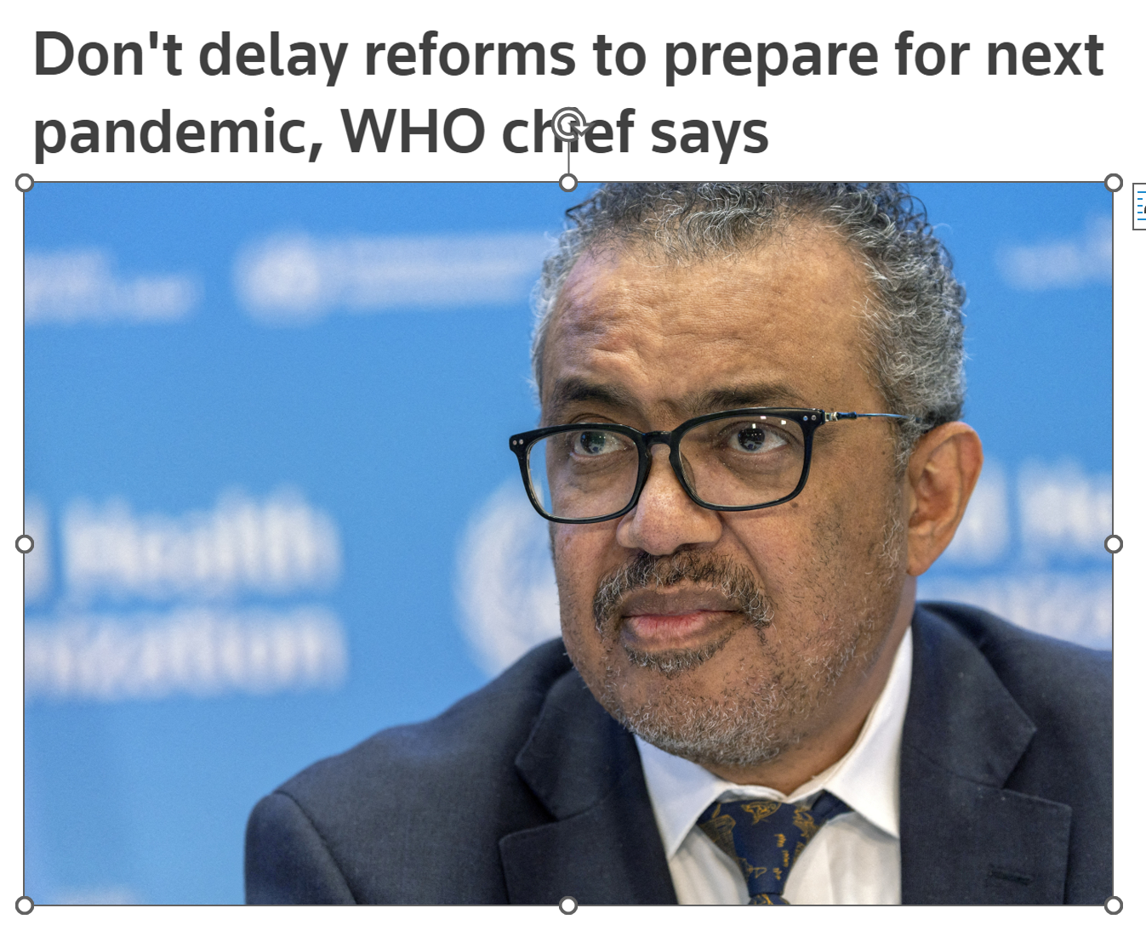


Did stringency influence happiness across the world over the course of the pandemic?
Notes:
data of 115 countries
Happiness and Stringency facets

Slide 3
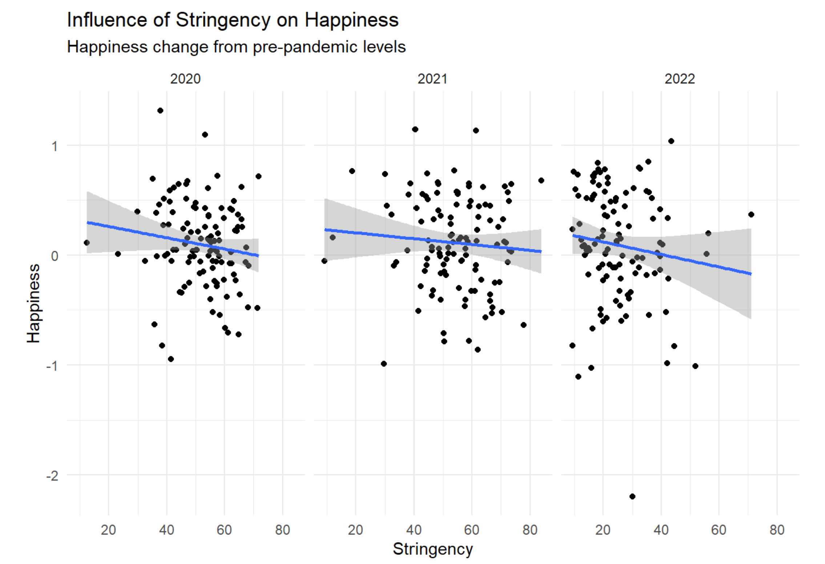
Notes:
- Comparing pandemic happiness with pre-pandemic average for each year across countries
- Explain centring
→ Our prediction was that happiness ratings in countries that applied more stringent measures would in turn have lower happiness ratings and that this effect would increase as the pandemic went on.

Slide 4




Photo by Markus Spiske
Photo by Olav Ahrens Rotne
Photo by Wolfgang Rottmann
Photo by cherrydeck

Slide 5



Photo by Júnior Ferreira
Photo by Shyam
Photo by Irham Setyaki
Notes:
Finding a project idea -> lot’s of PPDAC-Cycles and questions how to use the data
Found out relatively late about this when project idea was more or less “set”
E.g. idea to compare happiness to pre-pandemic average
Found an effect for 2022 w/o comparing to pre-pandemic average
Making the project round
Visualisation, Project idea, interpretation, keeping pitches short and concise
No use of bad research practice
Torture by Dirk and Rui

Slide 6

Thank you!

